Slide 1
Sink PPS High Level
May 15th , 2023

Slide 2
Sink PPS Steps
Monitor battery using battery gauge of some sort in order to understand battery charging requirements (voltage/current)*
Using MCU, take these voltage/current requirements and write to TPS65992 using Sink PPS Controls in Autonegotiate Sink Register (0x37) :
  Bits [96:102]: Operating current
  Bits [105:115]: Output voltage
* This is up to system requirements for how this can be achieved.

Slide 3
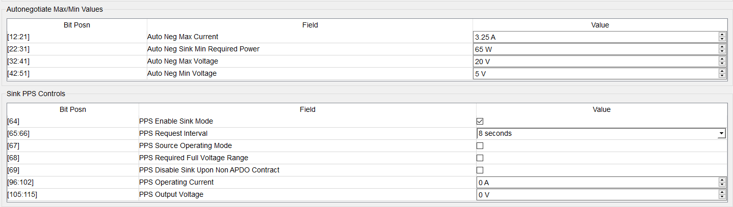
Autonegotiate Sink Register (0x37)
Updating these values will renegotiate sink APDO

Slide 4
Autonegotiate Sink Register (0x37)
Setting your interval time will dictate how often you renegotiate your APDO sink requests.

Slide 5
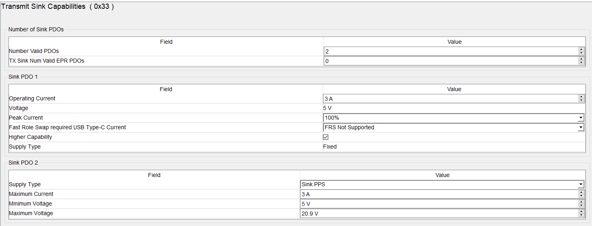
Transmit Sink Capabilities register (0x33)

